Slide 1
Introduction Software Testing
Software Engineering

Slide 2
Outlines
Software Testing Introduction,
What is testing?
Importance of testing
Testing terminologies
Principles of software testing,
Differences between Manual and Automation Testing.

Slide 3
Software Testing
Software testing is defined as an activity to check whether the actual results match the expected results and to ensure that the software system is Defect free.
Software testing also helps to identify errors, gaps or missing requirements in contrary to the actual requirements.
It can be either done manually or using automated tools

Slide 4
Purpose
Software testing is required to check the reliability of the software
Software testing ensures that the system is free from any bug that can cause any kind of failure
Software testing ensures that the product is in line with the requirement of the client
It is required to make sure that the final product is user friendly
At the end software is developed by a team of human developers all having different viewpoints and approach.
Even the smartest person has the tendency to make an error. It is not possible to create software with zero defects without incorporating software testing in the development cycle.
No matter how well the software design looks on paper, once the development starts and you start testing the product you will definitely find lots of defects in the design.

Slide 5
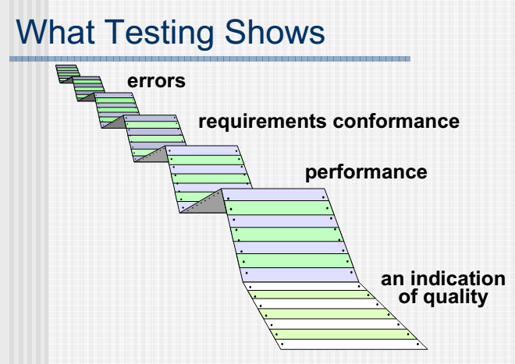

Out put of testing

Slide 6
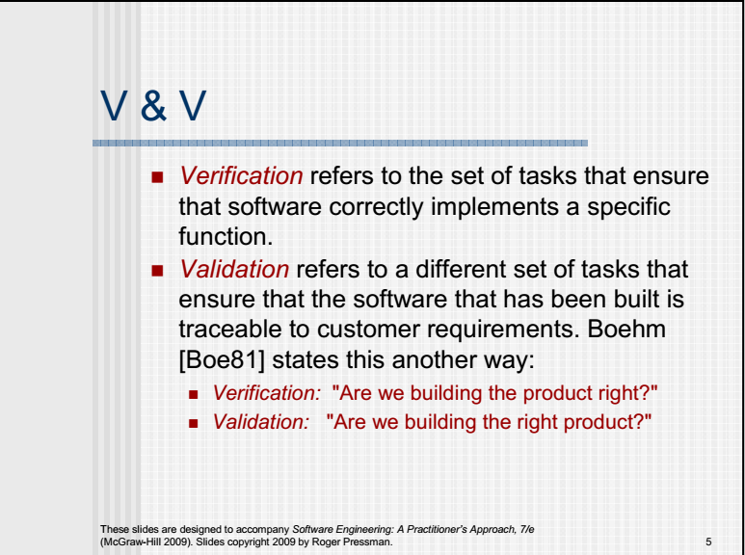
V & V

Slide 7
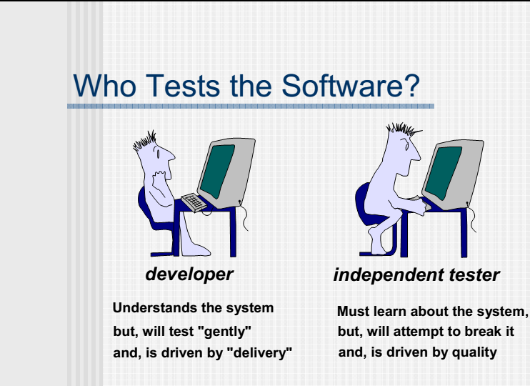
Who?

Slide 8
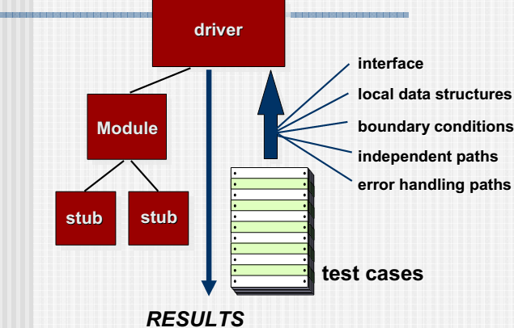
Testing Mechanism

Slide 9
Myths of testing
Myth: Anyone can do manual testing
Fact: Testing requires many skill sets
Myth: Testing ensures 100% Defect free product
Fact: Testing attempts to find as many defects as possible. Identifying all possible defects is impossible.
Myth: Automated testing is more powerful than manual testing
Fact: 100% test automation cannot be done. Manual Testing is also essential.
Myth: Testing is easy
Fact: Testing can be extremely challenging. Testing an application for possible use cases with minimum test cases requires high analytical skills.

Slide 10
7-Principles of software testing
#1) Testing Shows the Presence of Defects
In the software testing industry, no one will say that there is no defect in the software, which is quite true as testing cannot prove that the software is error-free or defect-free.
#2) Early Testing
Testers need to get involved at an early stage of the Software Development Life Cycle (SDLC).

Slide 11
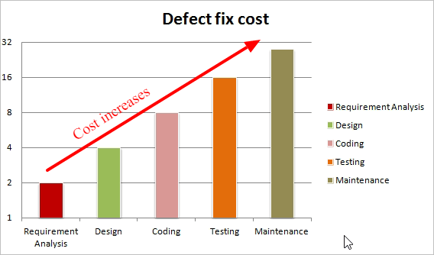
Cost required for fixing a defect found during the Requirement Analysis is less and it goes on increasing as we move towards the Testing or the Maintenance phase.

Slide 12
7-Principles of software testing
#3) Exhaustive Testing is Not Possible
It is not possible to test all the functionalities with all valid and invalid combinations of input data during actual testing. Instead of this approach, testing of a few combinations is considered based on priority using different techniques.
#4) Testing is Context-Dependent
Different domains are tested differently, thus testing is purely based on the context of the domain or application.
#5) Defect Clustering
During testing, it may happen that most of the defects found are related to a small number of modules.

Slide 13
7-Principles of software testing
#6) Pesticide Paradox
Pesticide Paradox principle says that if the same set of test cases are executed again and again over the period of time then these set of tests are not capable enough to identify new defects in the system.
#7) Absence of Error
If the software is tested fully and if no defects are found before release, then we can say that the software is 99% defect free. But what if this software is tested against wrong requirements? In such cases, even finding defects and fixing them on time would not help as testing is performed on wrong requirements which are not as per needs of the end user.

Slide 14
Categories Of Testing
Manual Testing
Manual testing is testing of the software where tests are executed manually by a QA Analysts. It is performed to discover bugs in software under development.
In Manual testing, the tester checks all the essential features of the given application or software.
In this process, the software testers execute the test cases and generate the test reports without the help of any automation software testing tools.

Slide 15
Categories Of Testing
Automation Testing
In Automated Software Testing, testers write code/test scripts to automate test execution. Testers use appropriate automation tools to develop the test scripts and validate the software.
The goal is to complete test execution in a less amount of time.
Automated testing entirely relies on the pre-scripted test which runs automatically to compare actual result with the expected results. This helps the tester to determine whether or not an application performs as expected.

Slide 16
Manual VS Automated Testing
Manual Testing | Automated Testing
Manual testing is not accurate at all times due to human error, hence it is less reliable. | Automated testing is more reliable, as it is performed by tools and/or scripts.
Manual testing is time-consuming, taking up human resources. | Automated testing is executed by software tools, so it is significantly faster than a manual approach.
Investment is required for human resources. | Investment is required for testing tools.
Manual testing is only practical when the test cases are run once or twice, and frequent repetition is not required. | Automated testing is a practical option when the test cases are run repeatedly over a long time period.
Manual testing allows for human observation, which may be more useful if the goal is user-friendliness or improved customer experience. | Automated testing does not entail human observation and cannot guarantee user-friendliness or positive customer experience.

Slide 17
TESTING TERMINOLOGY
Definitions Errors, Faults and Failures
An error is a human action that produces an incorrect result. A fault is a manifestation of an error in software. Faults are also known colloquially as defaults or bugs. A fault, if encountered, may cause a fault, which is a deviation of the software from its existing delivery or service.
Reliability
Reliability is the probability that software will not cause the failure of a system for a specified time under specified conditions. Measures of reliability include MTBF (mean time between failure), MTTF (mean time to failure) as well as service level agreements and other mechanisms.

Slide 18
TESTING TERMINOLOGY
Errors and how they occur
Why do we make errors that cause faults in computer software leading to potential failure of our systems? Well, firstly we are all prone to making simple human errors. This is an unavoidable fact of life. However, this is compounded by the fact that we all operate under real world pressures such as tight deadlines, budget restrictions, conflicting priorities and so on.

Slide 19
Testing VS Debugging
Testing:
Testing is the process of verifying and validating that a software or application is bug free, meets the technical requirements as guided by its design and development and meets the user requirements effectively and efficiently with handling all the exceptional and boundary cases.
Debugging:
Debugging is the process of fixing a bug in the software. It can defined as the identifying, analyzing and removing errors.
This activity begins after the software fails to execute properly and concludes by solving the problem and successfully testing the software.
It is considered to be an extremely complex and tedious task because errors need to be resolved at all stages of debugging.

Slide 20
Testing VS Debugging
TESTING | DEBUGGING
Testing is the process to find bugs and errors. | Debugging is the process to correct the bugs found during testing.
It is the process to identify the failure of implemented code. | It is the process to give the absolution to code failure.
Testing is the display of errors. | Debugging is a deductive process.
Testing is done by the tester. | Debugging is done by either programmer or developer.
There is no need of design knowledge in the testing process. | Debugging can’t be done without proper design knowledge.
Testing can be done by insider as well as outsider. | Debugging is done only by insider. Outsider can’t do debugging.
Testing can be manual or automated. | Debugging is always manual. Debugging can’t be automated.
It is based on different testing levels i.e. unit testing, integration testing, system testing etc. | Debugging is based on different types of bugs.

